Slide 1

EFMA, 2019
Heitor Almeida
Is it time get rid of Earnings-per-Share (EPS)?

Slide 2
My talk
Growing concern with short-termism, and possible negative effects on long-term investments
Series of recent papers linking earnings-per-share (EPS) targets to real investment decisions
Is it time to get rid of EPS?
If so how can we do it?

Slide 3
Real effects of short termism
Short termism and long-term investments
Gutierrez and Philippon (2016, 2017)
Low investment relative to profits and Q
Suggestion that it may be partly due to increase in institutional ownership and activism

Slide 4
Evidence on activism
Current evidence does not support claim that activism leads to short-termism
Brav, Jiang and Kim (2015), Brav, Jiang, Ma and Tian (2017), Bebchuk, Brav and Jiang (2015)

Slide 5
EPS targets and short termism
More compelling evidence of short-termist behavior
Firms change investment and payout decisions to meet EPS targets
Some evidence that these actions lead to worse long-term outcomes

Slide 6
Which EPS targets?
Analyst consensus EPS forecast
Compensation targets based on EPS
Acquirer EPS in an M&A deal

Slide 7
Meeting analyst consensus forecast
Graham, Harvey, and Rajgopal (2006)
CFOs are willing to take real economic actions, such as decreasing discretionary spending or delaying a new project, to meet analyst consensus EPS forecast
Recent empirical evidence supports survey evidence

Slide 8
Terry (2017)
Analyst EPS forecasts create discontinuity in R&D
2.6% lower R&D growth

Slide 9
EPS and repurchases
Almeida, Fos and Kronlund (2016)
Managers are willing to trade-off investments and
employment for stock repurchases that allow them to meet analyst EPS forecasts

Slide 10
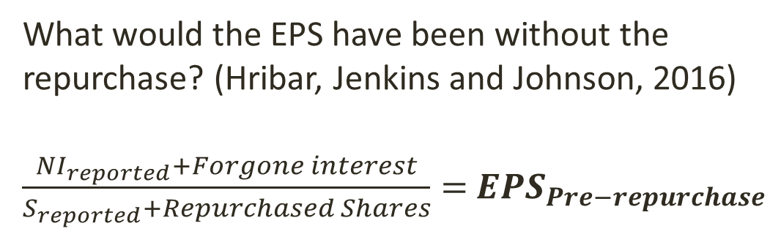
Pre-repurchase EPS surprises
What would the EPS have been without the repurchase? (Hribar, Jenkins and Johnson, 2016)
$\frac{{NI}_{reported}+Forgone interest}{S_{reported}+Repurchased Shares}=$ $EPS_{Pre−repurchase}$
We use it to compute pre-repurchase surprise

Slide 11
Discontinuity in repurchases
Notes:
37% of repurchase dollars are spent by firms in the small region just to the left of zero pre-repurchase EPS surprise

Slide 12
Employment
5% of mean number of employees (per million dollar in assets)

Slide 13
Investment
10% of mean number of employees (per million dollar in assets)

Slide 14
Compensation targets and short-termism
Bennett, Bettis, Gopalan and Milbourn (2016)
Equity and non-equity grants linked to explicit performance goals
Kinks in levels and slopes
Strong evidence that firms take actions to meet these compensation targets

Slide 15
Notes:
EPS-based goals are the most common (46%)

Slide 17
How do firms meet their EPS goals?
Firms that just exceed their EPS goals have higher abnormal accruals and lower R&D expenditures than firms that just miss EPS goals

Slide 18
EPS and mergers
Target EPS = acquirer’s pre-deal EPS
Stock deal is accretive to EPS if exchange ratio (including the premium) is lower than the ratio of the (pre-deal) EPS of the target to the EPS of the acquirer
Garvey, Milbourn and Xie (2013) find that EPS accretion criteria does a good job of predicting which firms are likely to become targets of M&A deals in a given industry
Identification issues (valuation motives)

Slide 19
EPS and deal structure
Dasgupta, Harford and Ma (2018) show that M&A deals are structured to avoid EPS dilution
If a stock deal dilutes EPS, under some conditions it is possible to make the deal accretive by increasing the cash component
Discontinuity in the choice of means of payment right at the point at which stock deal becomes dilutive

Slide 20
Summary
EPS targets have been associated with
Decline in R&D growth to meet analyst EPS forecasts
Stock repurchases that allow managers to meet EPS forecasts, at the cost of reducing investment and employment
Clustering in reported performance right at the point that triggers increase in managerial pay
Mergers that increase acquirer’s EPS

Slide 21
Is there anything to worry about?
Overinvestment or short termism?
It is not enough to look at announcement returns
Short-termism requires “short-term stock price” (Stein, 1989)
Short-term reaction to meeting EPS targets tends to be positive

Slide 22
Some evidence from the literature
Long-term underperformance
Ladika and Sautner (2017) and Edmans, Fan and Huang (2018) find that short-term concerns due to vesting equity lead to long-term underperformance
Almeida, Fos and Kronlund (2016) find that firms that cut investments because of EPS-driven repurchases have lower future ROA

Slide 23
Macroeconomic consequences ?
Terry (2017)
Short-term effect of EPS targets on R&D is reversed in future years, but…
Short-termism leads to 0.1% lower annual growth, or 0.5% loss in household welfare
Same ballpark as business cycles, gains from trade, or inflation

Slide 24
Intuition for Terry’s results
Short-termism increases the volatility of R&D by 25% in Terry’s benchmark calibrations
Under decreasing returns to scale in the production of innovation, this increase in volatility reduces overall innovation over time

Slide 25
Breaking the link
How can we break the link between EPS targets and short-termism?
Two layers
Changing compensation practices
Getting rid of EPS

Slide 26
Fixing compensation
Bennett et al. (2016)
Smoother link between performance and pay, rather than targets
Profits and sales targets rather than EPS
Multiple rather than single targets
Relative rather than absolute targets

Slide 27
Should we have profit targets at all?
Edmans (2017)
Costs may overwhelm the benefits
Why not pay CEOs using only cash and long-term equity?

Slide 28
EPS compensation and repurchases
See also Cheng, Harford and Zhang (2015) and Almeida and Cheng (2018)

Slide 29
Is it enough to change compensation?
Probably not
EPS drives stock prices and stock prices drive managers irrespective of compensation targets

Slide 30
EPS targets and stock prices
Meeting analyst EPS forecasts matters, controlling for the magnitude (Bartov, Givoly and Hain, 2002)
Updated evidence from Almeida, Fos and Kronlund
Just meet CAR (-1,1) = 0.23%
Just miss CAR (-1,1) = - 0.34%

Slide 31
Is it time to get rid of EPS?
This evidence seems to suggest that as long as managers care about stock prices they should have incentives to manage EPS
So perhaps the only real solution is to get rid of EPS altogether!

Slide 32
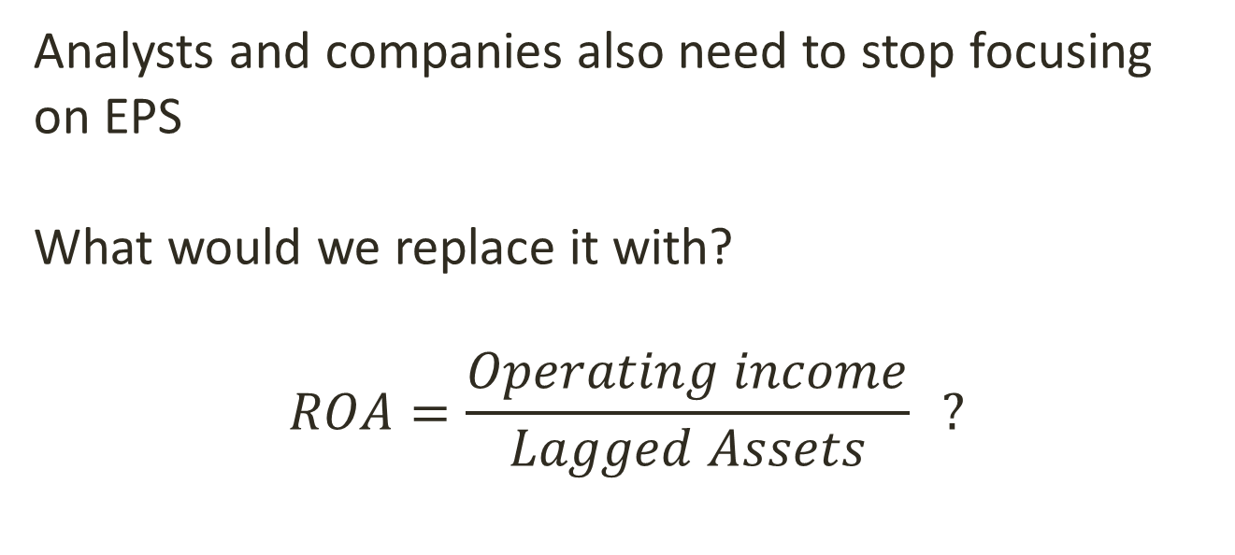
Replacing EPS
Analysts and companies also need to stop focusing on EPS
What would we replace it with?
$$ROA=\frac{Operating income}{Lagged Assets} ?$$

Slide 33
Ranges and multiple measures
Any single measure is likely to generate similar issues
Ranges
Next quarter ROA (or EPS) is expected to be between X and Y
Multiple measures
EPS should be X
ROA should be Y…

Slide 34
Would we be losing anything?
Are there significant costs to getting rid of EPS?
Is there an underlying rationale for the current equilibrium?

Slide 35
Why does the market respond so strongly to EPS?
Market cannot be reacting to performance
Not being able to come up with one or two cents of EPS can be a signal of hidden problems and lack of flexibility (De Jong, Mertens, Van der Poel and Van Dijk, 2014)
Earnings surprises contain information about future earnings (Bartov, Givoly and Hain, 2002)

Slide 36
Signaling?
Is this a type of signaling game?
What exactly is being signaled?
My student’s theory
Some managers don’t understand that they can use tricks to meet EPS forecasts
Using a trick is a sign of financial/accounting skills

Slide 37
Bad equilibrium?
Maybe it is possible to come up with a positive theory that explains why we focus so much on a single metric that does not measure performance
But it may also be that finance is trapped in a “bad equilibrium”

Slide 38
How do we do change this situation?
Research
Several open research topics in this area
Media
Non-academic articles, interviews, etc.
Teaching
Talk about these issues with our students

Slide 39
Teaching
There is evidence that teaching Finance principles can change decision-making at companies
Gitman and Forrester (1977): in the mid 1970s only 10% of firms appeared to use NPV as their primary capital budgeting tool
Graham and Harvey (2002) find that most companies (and in particular larger firms) use net present value (NPV) techniques

Slide 40
Research
There is also evidence that Finance research can influence decision-making and change how financial markets operate
Black and Sholes
McLean and Pontiff (2016)

Slide 41
Open research topics
What determines how managers decide among different methods to meet EPS targets? For example R&D versus accruals
History of EPS. When did analysts and firms start focusing on EPS, and why?
Data from countries other than US
Which investments get cut because of EPS targets? Do firms cut marginal projects first?
Do EPS targets really drive M&A?

Slide 42
Open research topics
6. Are there any benefits of EPS targets and if so what are they?
7. Would performance goals other than EPS really reduce short-termism? We would probably need to identify situations in which EPS is dropped from compensation contracts for quasi-exogenous reasons to answer this question

